Slide 1
UNIT 4
TYPES OF DATA MODEL

Slide 2
Data Model
A data model is a diagrammatic representation of the data and the relationship between its different entities.
It assists in identifying how the entities are related through a visual representation of their relationships and thus helps reduce possible errors in the database design.
There are three types of data model:
Conceptual data model
Logical data model
Physical data model

Slide 3
Data Model
A data model is a diagrammatic representation of the data and the relationship between its different entities.
It assists in identifying how the entities are related through a visual representation of their relationships and thus helps reduce possible errors in the database design.

Slide 4
Conceptual Data Model
It is designed by identifying the various entities and the highest-level relationships between them as per the given requirements.
Features of a conceptual data model:
Identifies the most important entities.
Identifies the relationships between different entities.
Does not support the specification of attributes.
Does not support the specification of primary key.

Slide 5
Logical Data Model
It is used to describe data in as much detail as possible.
Features of a logical data model:
Identifies all entities and the relationships among them.
Identifies all attributes for each entity.
Specifies the primary key for each entity.
Specifies the foreign keys.
Normalization of entities is performed at this stage.

Slide 6
Comparison Between Conceptual and Logical Data Model
Conceptual Data Model | Logical Data Model
No attributes are specified. | All attributes for each entity are specified.
No Primary key is present. | Primary keys are present.
The relationships are stated without specifying attributes. | The relationships between entities are specified using primary keys and foreign keys.

Slide 7
Physical Data Model
It is a representation of how the model will be built in the database.
It exhibits all the table structures, including column names, columns data types, column constraints, primary key, foreign key and the relationship between tables.
Features of a physical data model:
Specification of all tables and columns.
Foreign keys are used to identify relationship between tables.
Physical data model may support de-normalization based on user requirements.
Physical data model will be different for different RDBMS.

Slide 8
Steps for designing a physical data model
Convert entities into tables/relation
Convert relationships into foreign keys.
Convert attributes into columns/fields.

Slide 9
Data modeling techniques
Normalization(Entity Relationship)Modeling
A table/relation in Third Normal Form(3NF) has no transitive dependency of a non-key attribute on the primary key.
This is achieved by decomposing and forming a relation that includes the non-key attribute(s) that functionally determine(s) other non-key attribute(s).
The ER model makes use of the 3 NF design technique.

Slide 10
ER Model
Steps for designing ER model:
1.Identify all the entities.
2.Identify the relationships among the entities along with cardinality and participation type.
3. Identify the key attribute or attributes.
4. Identify all other relevant attributes.
5.Plot the ER diagram with all attributes including key attribute(s).
6.The ER diagram is then reviewed with the business users.

Slide 11
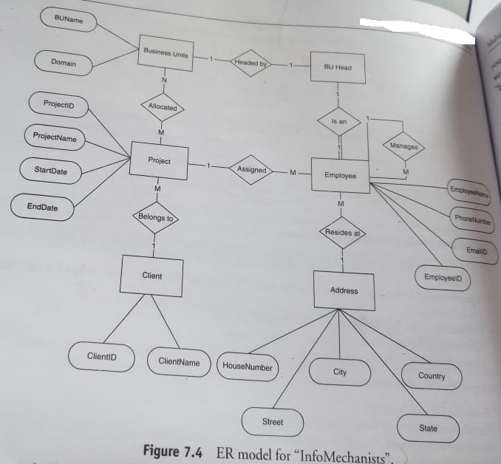
ER Model

Slide 12
ER Modeling
Advantages:
The ER diagram is easy to understand and is represented in a language that the business users can understand.
It can also be easily understood by a non-technical domain expert.
It is intuitive and helps in the implementation on the chosen database platform.
It helps in understanding the system at a higher level.
Disadvantages:
The physical designs derived using ER model may have some amount of redundancy.
There is scope for misinterpretations because of the limited information available in the diagram.

Slide 13
Dimensional Modeling
The method of analyzing a performance measure by looking at it through various perspectives, or in other words the contextualized representation of a business performance measure, is known as dimensional modeling.
It divides the database into two parts:
Measurement
Context
Measurements are captured by the various business processes and other source systems.
These measurements are usually numeric values called facts.
Facts are enclosed by various contexts that are true at the moments the facts are recorded.
These contexts are intuitively divided into independent logical clumps called dimensions.Dimensions describe the “who”, ”what”, ”when” context of the measurements.

Slide 14
Dimensional Modeling
Ex: Booking an airline ticket.
Facts-Number of tickets booked, amount paid
Dimensions-Customer details, airlines, time of booking
Benefits of Dimensional Modeling:
Comprehensibility
Improved query performance
Trended for data analysis scenarios.

Slide 15
Fact Table
Consists of various measurements.
Stores the measures of business processes and points to the lowest detail level of each dimension table.
Measures are factual or quantitative in representation,generally numeric in nature.
They represent how much or how many aspect of a question.

Slide 16
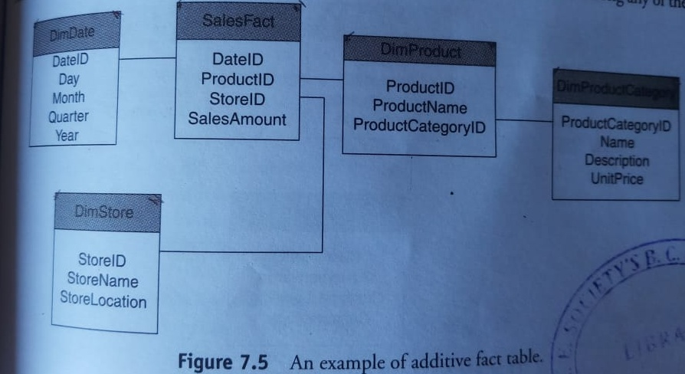
Types of Fact
Additive Facts:
These are the facts that can be summed up/aggregated across all dimensions in a fact table.
Ex:Discrete numerical measures of activity-quantity sold,dollars sold etc.

Slide 17
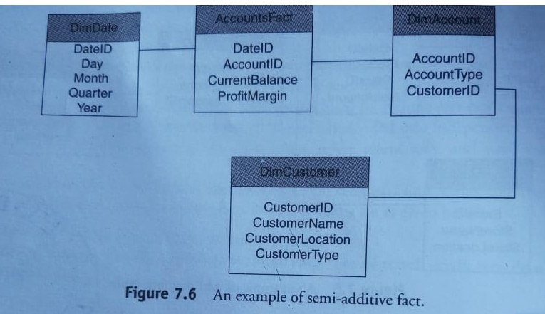
Types of Fact
Semi -Additive Facts:
These are the facts that can be summed up for some dimensions in the fact table, but not all.
Ex: Account balances, inventory level, discount counts,etc.

Slide 18
Types of Fact
Non -Additive Facts:
These are the facts that cannot be summed up for any of the dimensions present in the fact table.
Facts where the SUM operator cannot be used to produce any meaningful results.
Ex:measurement of room temperature,percentages,ratios,factless facts,etc.

Slide 19
Dimension Table
They consist of dimension attributes
Dimension attributes are typically static values containing textual data.
Their functionalities are:query filtering/constraining and query result set labeling.
The dimension attribute must be:
Verbose
Descriptive
Complete
Discrete values
Quality assured

Slide 20
Dimension Hierarchies
A dimension hierarchy is a cascaded series of many one-to-one relationships and consists of different levels.
Each level in a hierarchy corresponds to a dimension attribute.
Hierarchies document the relationships between different levels in a dimension.

Slide 21
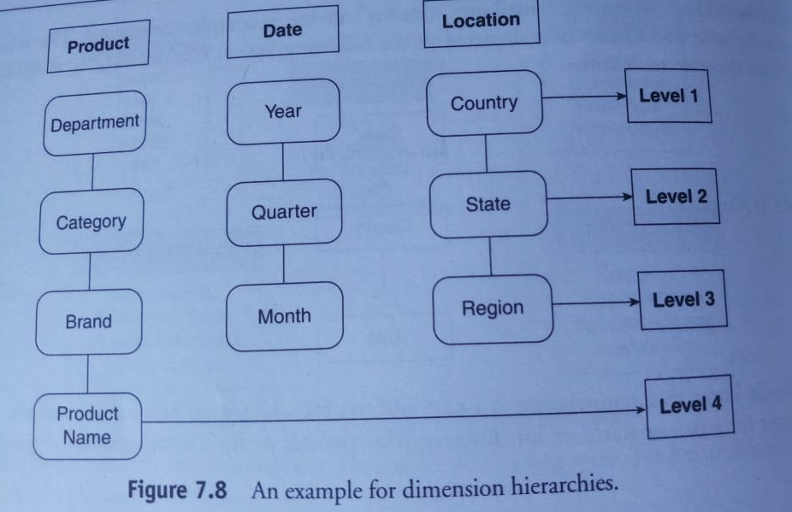
Dimension Hierarchies

Slide 22
Types of Dimension Tables
Degenerate Dimension
Slowly Changing Dimension
Rapidly Changing Dimension
Role-playing Dimension
Junk Dimension

Slide 23
Degenerate Dimension
It is a dimension without any attribute.
Usually,it is a transaction-based number.
Degenerate dimensions can also be called textual facts.

Slide 24
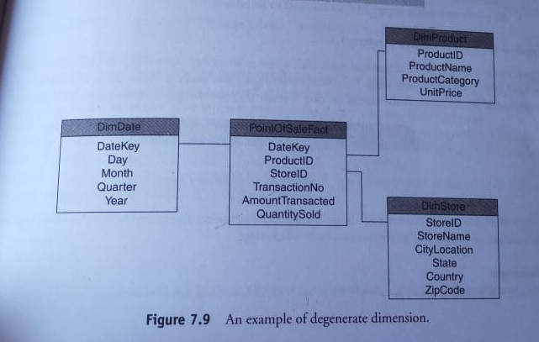
Degenerate Dimension

Slide 25
Slowly Changing Dimension
It is a dimension whose attributes/attribute for a record(row)change slowly over time, rather than change on a regular timely basis.
Approaches for handling a slowly changing dimension:
Type-I(Overwriting the history)
Type-II(Preserving the history)
Type-III(Preserving one or more versions of History)

Slide 26
Type-I(Overwriting the history)
The existing attribute dimension is overwritten with new data, and hence no history is preserved.
This approach is used when correcting data errors present in a field.
Advantages:
Easy and simple to implement.
Effective in situations requiring the correction of bad data.
No change is needed to the structure of the dimension table.
Disadvantages:
All history may be lost.
All previously made aggregated tables need to be rebuilt.

Slide 27
Type-II(Preserving the history)
A new row is added into the dimension table with a new primary key every time a change occurs to any of the attributes in the dimension table.
Both the original values and the newly updated values are captured.
Advantages:
This approach enables to accurately keep track of all historical information.
Disadvantages:
The size of the table will grow fast
Complicates ETL process
Storage and performance can become a serious concern

Slide 28
Type-III(Preserving one or more versions of history)
This approach is used when it is compulsary for the data warehouse to track historical changes, and when these changes will happen only for finite number of times.
Advantages:
Does not increase the size of the table.
It allows to keep some part of history.
Disadvantages:
Type-III SCD’s will not be able to keep all history where an attribute is changed more than once.

Slide 29
Rapidly Changing Dimension
A dimension is considered to be rapidly changing dimension,if its one or more attributes change frequently and also in several rows.
Some of the fast changing dimension attributes are identified as:
Age
Income
Rating
Fast changing dimensions can be handled by breaking off a fast changing dimension into one ore more separate dimensions known as mini- dimensions.
The fact table would then have 2 foreign keys:
Primary dimension table
Fast changing attributes

Slide 30
Role-Playing Dimension
A single dimension that is expressed differently in a fact table with the usage of views is called a role-playing dimension.
Ex: Broker dimension. The broker can play the role of both sell broker and buy broker in a share trading scenario.

Slide 31
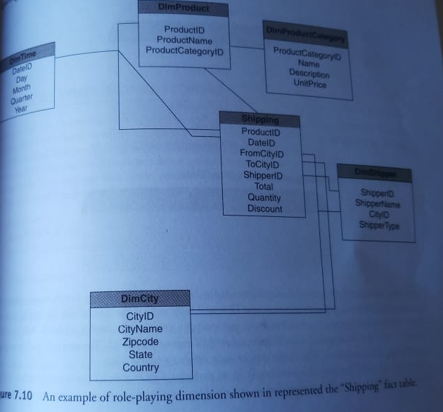
Role-Playing Dimension

Slide 32
Garbage Dimension
The garbage dimension is a dimension that contains low-cardinality columns/attributes such as codes , status flags.
It is also known as Junk Dimension.
The attributes in a garbage dimension are not associated with any hierarchy.
Two ways to build the junk dimension:
Perform a cross-join of the source tables.
Actual attribute combinations found in the source tables for the fact table.

Slide 33
Typical Dimension
Models
Dimensional modeling is generally represented by either of the following schemas:
Star Schema
Snowflake Schema
Fact Constellation Schema

Slide 34
Star Schema
It is the simplest of data warehousing schema.
It consists of a large central table (called the fact table) with no redundancy.
The central table is being referred by a number of dimension tables.
The fact table is in 3NF.Dimension tables are in 2 NF.
Dimension tables are also known as look up or reference tables.

Slide 35
Data model for Star Schema
Dimension
Dimension
Fact Transaction
Dimension
Dimension

Slide 36
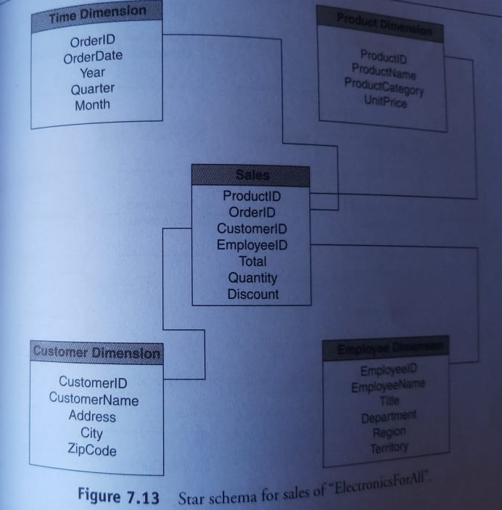
Star Schema

Slide 37
Snowflake Schema
It is a variant of the Star schema.
The centralized fact table is connected to multiple dimensions.
Dimensions are present in a normalized form in multiple related tables.
A snowflake structure materializes when the dimensions of a star schema are detailed and highly structured, having several levels of relationship, and the child tables have multiple parent tables.
Snowflaking: A dimension table is said to be snowflaked if the low-cardinality attributes of the dimensions have been divided into separate normalized tables.
These tables are then joined to the original dimension table with referential constraints.
The dimensional model is snowflaked under the following conditions:
The dimension table consists of two or more sets of attributes which define information at different grains.
The sets of attribute of the same dimension table are being populated by different source systems.

Slide 38
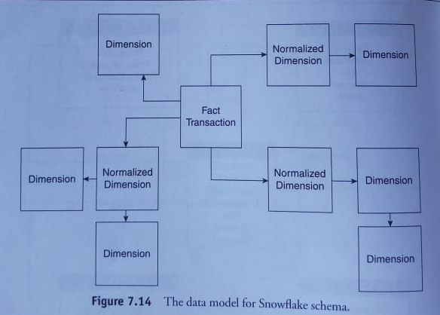
Snowflake Schema

Slide 39
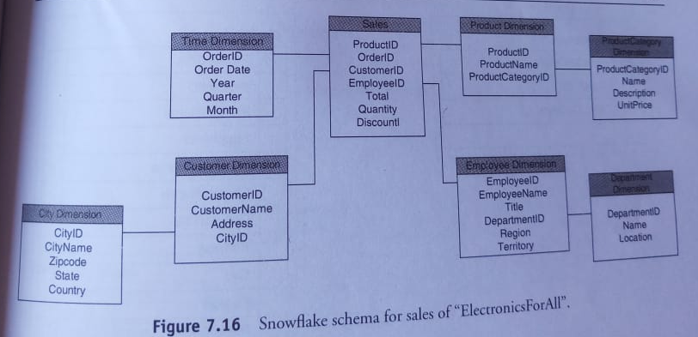
Snowflake Schema

Slide 40
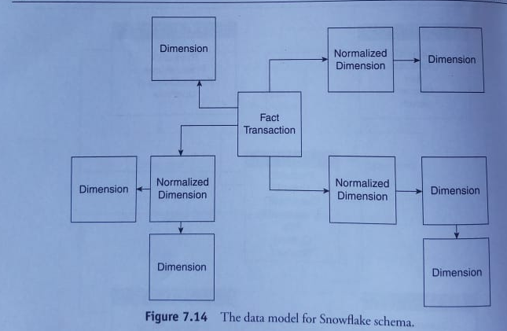
Snowflake Schema

Slide 41
Fact Constellation Schema
It is shaped like Constellation of stars.
It is more complex than Star or Snowflake schema variations as it contains multiple fact tables.
This allows the dimension tables to be shared among the various fact tables.
It is also called “Galaxy Schema”.
Disadvantage:It is more complicated to design because multiple aggregations must be taken into consideration.

Slide 42
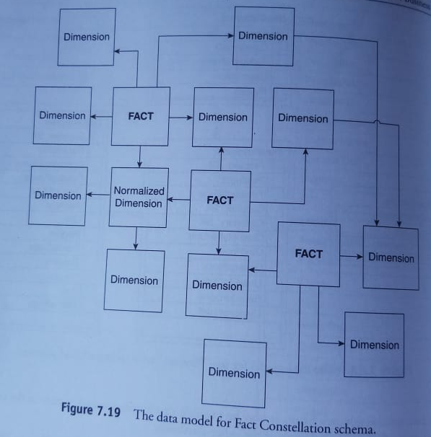
Fact Constellation Schema

Slide 43
Dimensional Modeling Life Cycle
Phases of Dimensional Modeling Life Cycle:
Requirements gathering
Identify the grain
Identify the dimensions
Identify the facts
Design the dimensional model

Slide 44
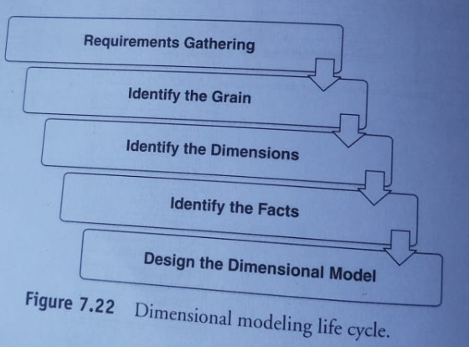
Dimensional Modeling Life Cycle

Slide 45
Requirements Gathering
It is the process of selecting the business processes for which the dimensional model will be designed.
There are two methods for deriving business requirements:
Source driven requirements gathering
User-driven requirements gathering

Slide 46
Source driven requirements gathering
It is a method in which requirements are determined by using the source data in production operational systems.
This is done by analyzing the ER model of source data and selecting data elements that seem to be of interest.
Advantages:
From the beginning you know what data you can supply because you limit yourself to what is available.
The time spent on gathering requirements from the users in the early stages of the project is saved.
Disadvantages:
Minimal user involvement increases the risk of producing an incorrect set of requirements.
The approach can be very time consuming.
Some of the user’s key requirements may need the data that is currently unavailable. Without identifying these requirements, there is no chance to investigate what external data is required.

Slide 47
User driven requirements gathering
It is a method based on identifying the requirements by analyzing the functions that the users perform.
Advantages:
It focuses on providing what is really needed rather than what is available.
It generally produces a useful data in a shorter span of time.
Disadvantages:
The approach can be very time consuming as the user requirements may change over time.
If a user is too focused,it is possible to miss useful data that is availablein the production systems.
The users might have unrealistic expectations.

Slide 48
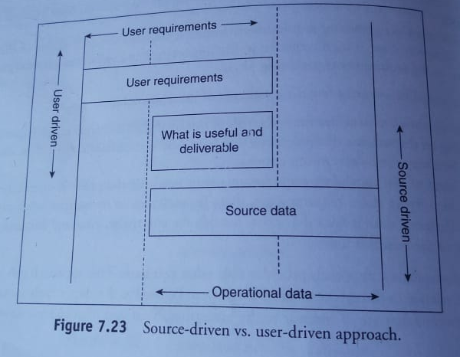
Source driven vs User driven approach

Slide 49
Source driven vs User driven approach
The ideal approach is to design the data warehouse keeping in mind both the user requirements and the source data available.
While gathering requirements the following questions could be asked:
Who are the groups , organizations , people of interest?
Why do we require data?
What functions are required to be analyzed?
When should the data be recorded?
What factors decide the success or failure?
How is the performance of the processes being analyzed?
How is the performance of the various business modules measured?
What level of detailing would enable data analysis?
What steps are presently taken to fulfil the information?
What is the method used for distribution of information?

Slide 50
Identify the grain
The “grain” refers to the level of detail or fineness to which the data can be analyzed.
It is the finest level of detail implied by the joining of the fact and dimension tables.
Consider the following tables with their attributes:
Date(year ,quarter ,month, day)
Store(region, district and store)
Product(category name, price and product)
For this group of tables, some examples of grain are:
A daily snapshot of the inventory levels for each product in a warehouse.
A single item on an invoice.
A single item on an restaurant bill.
A monthly snapshot for balance of each bank account.
The product sold in a store in a day.

Slide 51
Identify the grain
Granularity:
It is defined as the detailed level of information stored in a table.
The more the detail,the lower is the level of granularity.
The lesser the detail,the higher is the level of granularity.
Example:
If we consider a table LocationA(Country,State),it will have a granularity at the state level.
If the table is modified and changed to LocationB(Country,State,City),it will now have granularity at the city level.

Slide 52
Identify the dimensions
Once the grain has been identified, the next step is to determine the dimensions for the data model.
The key features of a dimension table are:
Dimension tables contain attributes that describe facts in the fact table.
Each dimension table has only one lowest level of detail called the dimension grain ,also referred to as the granularity of the dimension.
Each non-key element should appear in a single dimension table.

Slide 53
Identify the facts
After identifying the dimensions in the model, the next step is to identify the fact table and the relevant facts/measures in that table.
Before identifying the relevant facts/measures it is necessary to identify the fact tables in the database design.
The following features of fact table will help to identify the fact tables:
The fact table will mostly contain numeric and additive values.
It contains at least two foreign keys.
It usually comprises vast number of records.
Tables having many-to-many relationship in an ER model can be used as fact tables in a dimensional model.

Slide 54
Identify the facts
Having identified the fact table , the next step is to identify the facts/measures for the same.
While identifying the facts the following points should be kept in mind:
A fact should generally be numeric in nature.
It should be of importance to the business analysis.
It should confirm the grain level identified in the step “Identify the grain”.

Slide 55
Designing the dimensional model
Draw a Star/Snowflake/fact Constellation model.

Slide 56
Understanding measures and performance
Basic measures-length ,mass and time.
Virtually everything around us has a system of measurement.
Performance is all about achieving goals/results.
To analyze Performance and to declare achievements “measures” and systematic data/facts collection is necessary.

Slide 57
Measurement System Terminology
Data:It is a collection of facts which have similar attributes or characteristics.
Ex:Phone number,Email ID’s
Measure:data with associated unit of measure is typically termed as measure.
Ex:Lab hours per month
Metric: It is a system of measures based on standard UOM with a business context.
Ex:Product defect rate

Slide 58
Measurement System Terminology
Indicator: Business metric used to track business results or success/performance.
Ex: Call drop frequency , Earnings per share
Index: It consists of a composite set of indicators used to address the overall health of business operations.
Ex: Customer satisfaction index, market performance index

Slide 59
Measurement System Terminology
A metric data when properly defined includes four components:
Subject:This measure is about a customer,a product,a supplier.
Quantum:It is the value of the measure, such as cost,frequency,duration.
Stratum:It is the grouping consideration expressed like By Location,By Quarter.
Application:Value compared with similar measurements like previous month.target.

Slide 60
Navigating a business enterprise
Businesses depend on measurements that help business leaders navigate the enterprise.
Each business function will need its own goals and measurements to ensure that the entire company achieves business success together.
Business leaders too depend on key functions such as
human resource,finance,sales,marketing,research,porduction,facilities to reach business goals.
Every team within each function needs to reach its goals.
This in business performance terms is called alignment.

